Slide 1
Swap Shop Inventory Tool (SSIT)
3/c Charlotte Braman & 3/c Kathrine Doty

Slide 2
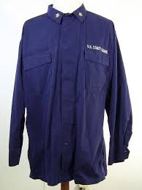
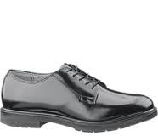
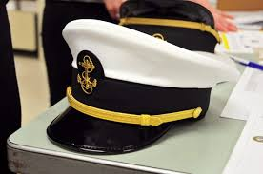
Swap Shop Overview
Variety of uniform items
Swap items
Pay cash or Venmo for items
Donate items
Golf Swap Shop Division is responsible for maintenance
Google Sheet organizes inventory

Slide 3
Motivation for the SSIT

Slide 4
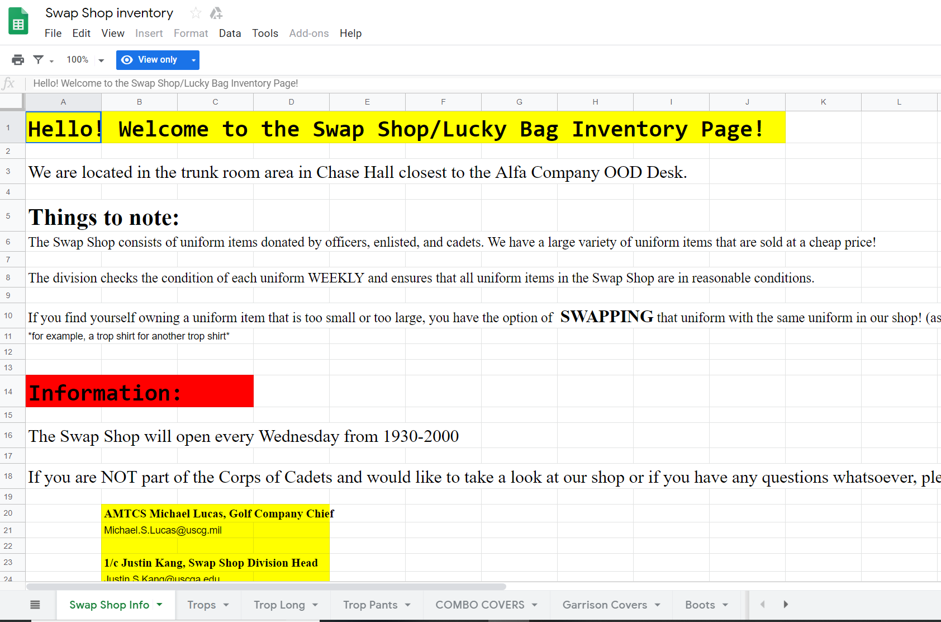

Slide 5
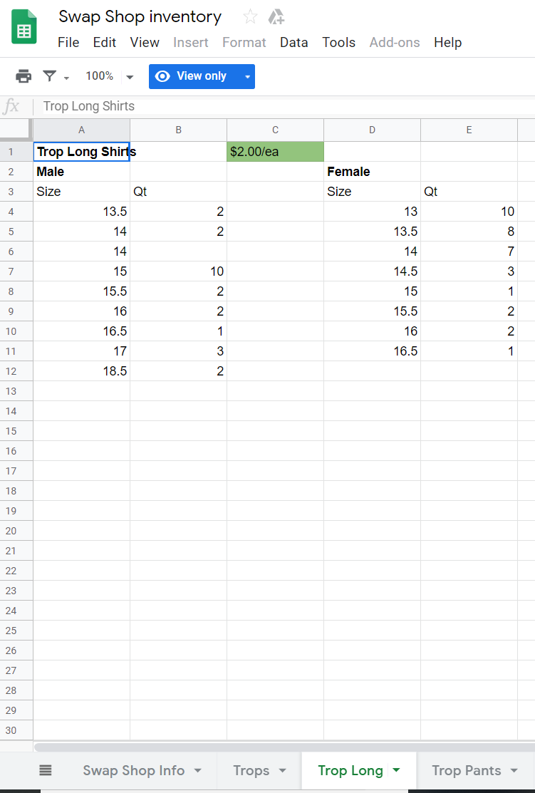
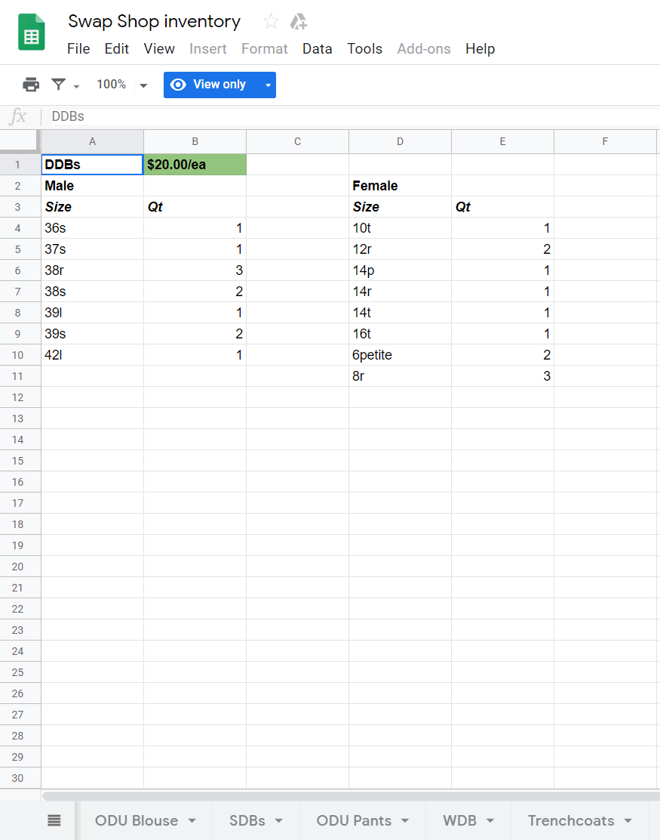

Slide 6
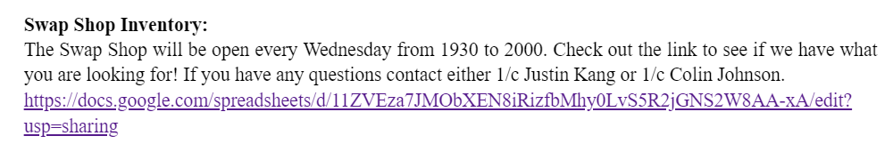
THE WHY
Charlotte’s Division
Applicable to Cadet Life
Better accountability of money and Coast Guard uniform items

Slide 7
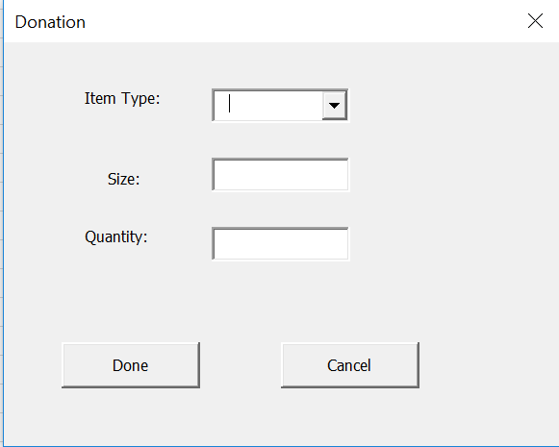
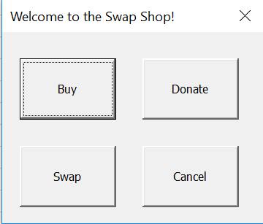
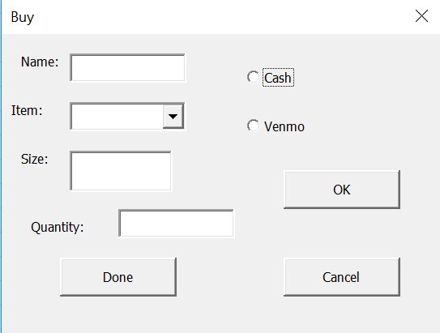
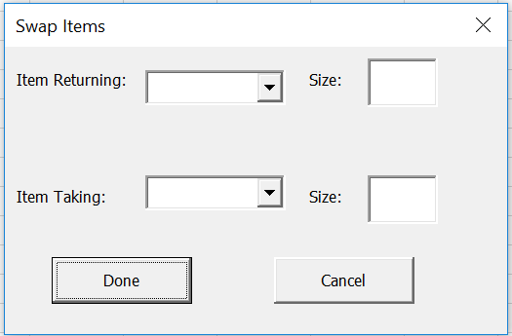
Visuals

Slide 8
Let’s give the SSIT a try!

Slide 9
End of the Night Reports

Slide 10
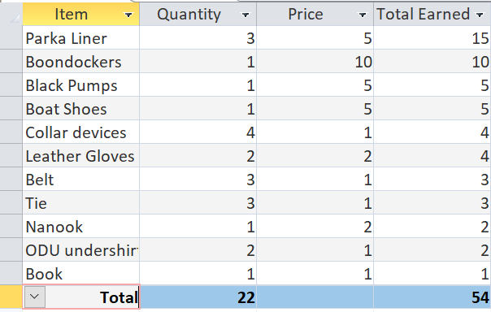
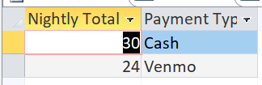
Total Earned

Slide 11
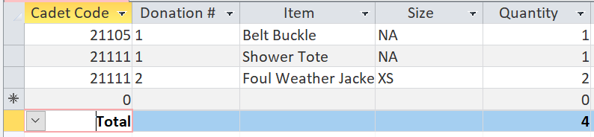
Items Sold/Swapped

Slide 12
Program Limitations/Assumptions
Limited Access knowledge required to perform additional queries
SSIT Future Goals
  Accurate Sizes
    Sizes for Boots differ from sizes for Trop Pants which differ from sizes for ODU blouses, etc
  Corpswide access to current inventory
    Publish a weekly report in POD
  Add button on UserForm to display nightly balance
Notes:
Accurate sizes:Sizes for Boots differ from sizes for Trop Pants which differ from sizes for ODU blouses, etc

Slide 13
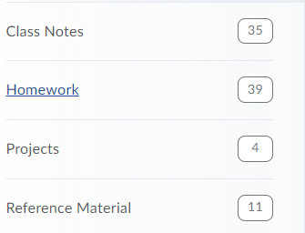

Lessons Learned
Break the project up into small portions
  Outline, checklist
Keep overall goal in mind
Use previous examples
  In-Class exercises, homework, etc.
Notes:
Overall goal= may have to get rid of some work to make the tool most effective

